Slide 1
A5: MS Azure Data Lake and visualization
Tutorial

Slide 2
Overview
To learn data analytics using MS Azure Data Lake
To learn use of data analytics dashboard
To learn real time data analysis with pattern detection
To learn big data analysis using big data tools available in cloud

Slide 3
Prerequisites
Create Azure account:
https://azure.microsoft.com/en-us/free/
Install Power BI on your local machine:
https://powerbi.microsoft.com/en-us/downloads/
Or Tableau:
https://www.tableau.com/products/desktop/download

Slide 4
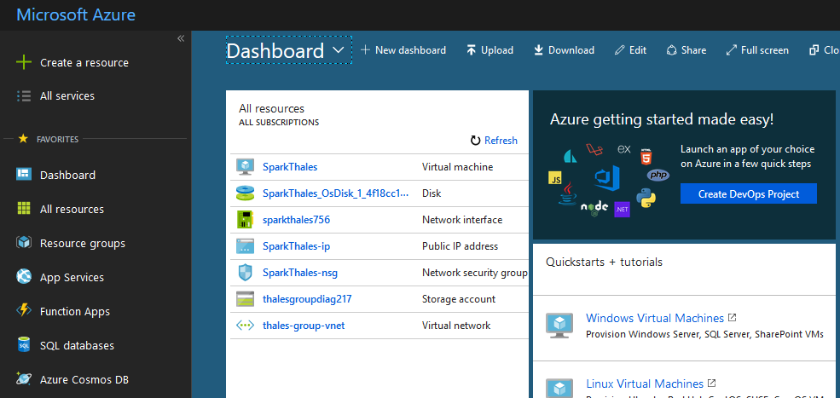
CREATE DATA LAKE
Once you login, you’ll se the dashboard:

Slide 5
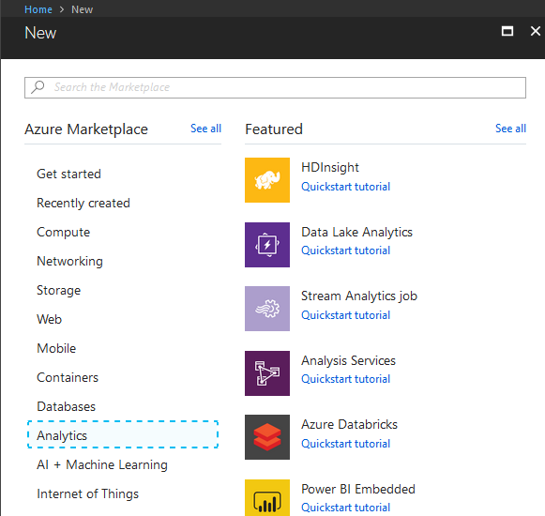
CREATE DATA LAKE
Create new resource
Choose Analytics
Choose Data Lake Analytics

Slide 6
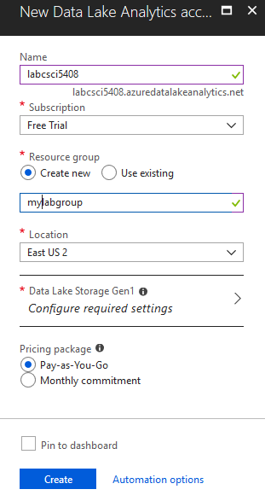
CREATE DATA LAKE
Choose name
Choose group name
Click Data Lake Storage Gen1

Slide 7
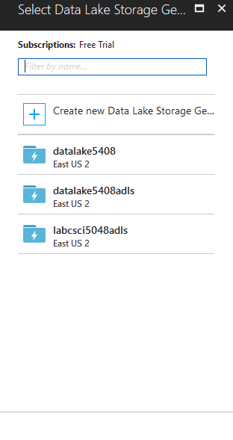
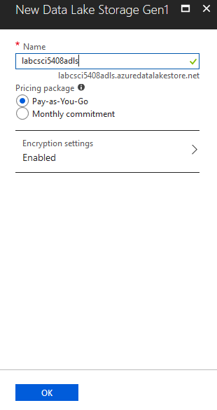
CREATE DATA LAKE
Choose Create new Data Lake Storage Gen1
In next panel choose name
Click ok
And click Create on the first parent panel for Dala Lake Analytics creation

Slide 8
Data upload to Data lake

Slide 9
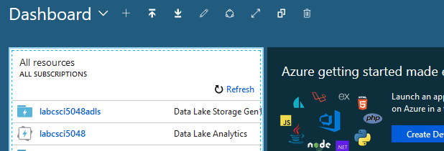
UPLOAD Data
Once it’s deployed, the main dashboard should contain both, DL analytics and storage
Click on DL Analytics instance that was created

Slide 10
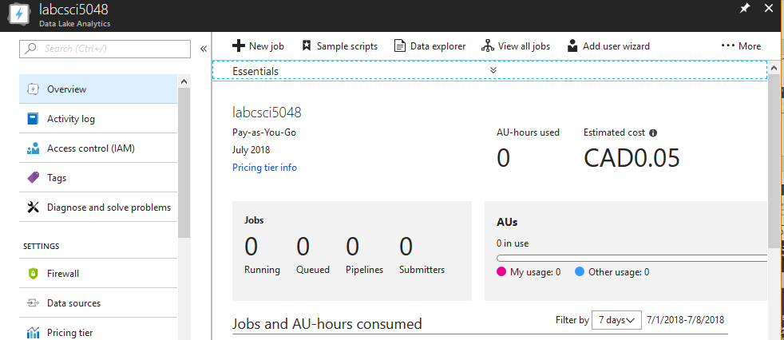
UPLOAD DATA
On the top bar choose Data Explorer

Slide 11
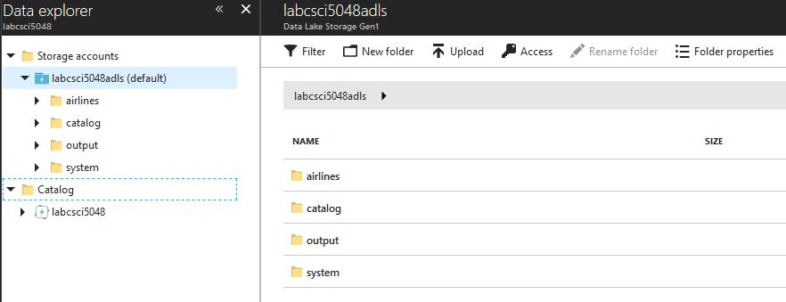
UPLOAD DATA
On the Data Explorer panel under Storage Accounts choose Storage
On the top bar on the chosen account on the right choose Upload or create new folder, and then upload the data inside the folder

Slide 12
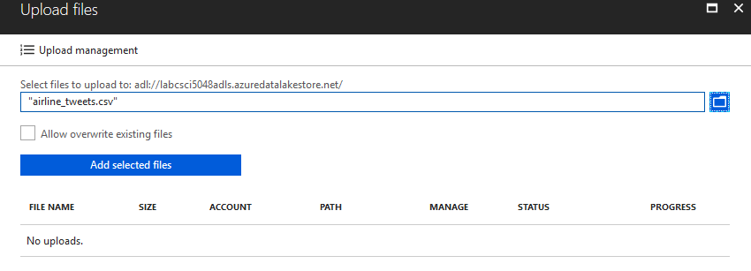
UPLOAD DATA
Select csv file from your local machine.
Click Add Selected Files
Note: if you have xls, xlsx file, first convert it to csv

Slide 13
Data querying from portal
Azure offers many ways how to query your data.
PowerShell, Azure CLI, SDKs, Portal
Depending on your use case, you choose one over another
The easiest one is through Portal

Slide 14
DATA QUERYING FROM portal
Go to Data Lake analytics portal and choose New job

Slide 15
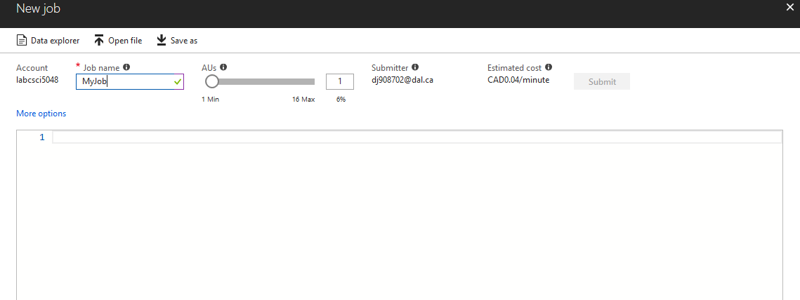
DATA QUERYING FROM portal
Choose name for the job, and start writing u-sql script
Once your script is ready, choose Submit

Slide 16
U-SQL on azure
To learn more about U-SQL take a look at the official documentation:
https://docs.microsoft.com/en-us/azure/data-lake-analytics/data-lake-analytics-u-sql-get-started
It’s very similar to SQL, but allows you to work with different resource types

Slide 17
U-SQL PARSE CSV EXAMPLE
@searchlog =
EXTRACT tweet_id long, -- Make sure to have all columns from your uploaded csv
airlines_sentiment string,
airline_sentiment_confidence float,
negativereason string,
negativereason_confidence string,
airline string,
airline_sentiment_gold string,
name string,
negativereason_gold string,
retweet_count int,
text string,
tweet_coord string,
tweet_created string,
tweet_location string,
user_timezone string
FROM "/airlines/airline_tweets.csv“ -- In this case, the csv is uploaded in “airlines” folder
USING Extractors.Csv(encoding: Encoding.UTF8,skipFirstNRows:1);
-- https://msdn.microsoft.com/en-us/azure/data-lake-analytics/u-sql/extractors-csv
OUTPUT @searchlog
TO "/output/airlines-u-sql.csv“ – Saving the results to output, you’ll find output folder in the storage after execution
USING Outputters.Csv(outputHeader: true);

Slide 18
U-SQL Select columns EXAMPLE
@rs1 =
SELECT tweet_id, airlines_sentiment, text
FROM @searchlog -- previously parsed csv
WHERE airlines_sentiment == "positive";
OUTPUT @rs1
TO "/output/positive-tweets.csv"
USING Outputters.Csv(outputHeader: true);

Slide 19
POWER BI data import

Slide 20
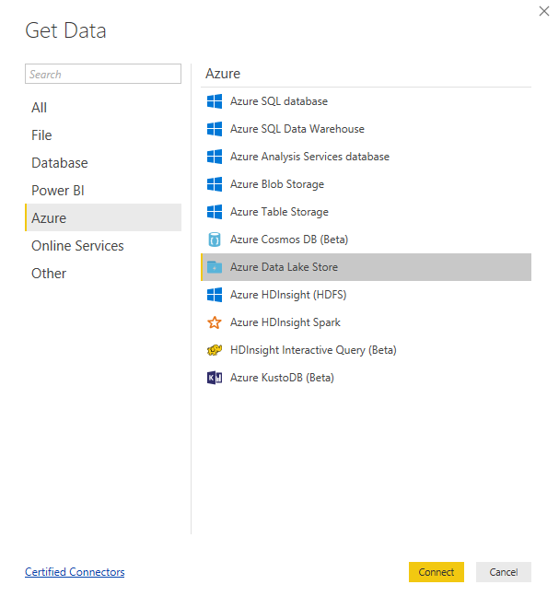
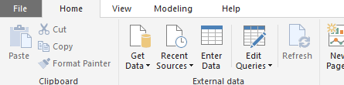
DATA IMPORT
Select Get Data on top toolbar
On the opened window select Azure Data Lake Store

Slide 21
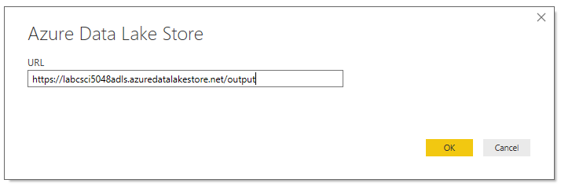
DATA IMPORT
Paste the url to your Data Lake Storage
You can find it on your storage dashboard, under section Essentials

Slide 22
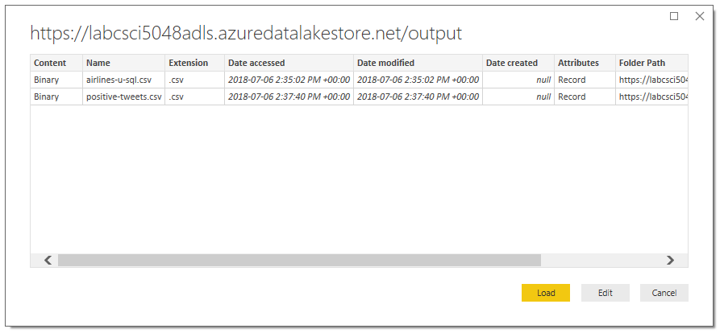
DATA IMPORT
Before you click on Load

Slide 23
DATA IMPORT
The data you imported is not ready yet for manipulation.
Please follow the instructions in the official documentation to edit the data in Power BI:
https://docs.microsoft.com/en-us/azure/data-lake-store/data-lake-store-power-bi

Slide 24
Python sdk for azure
(ALTERNATIVE, not mandatory for the assignment completion)

Slide 25
Connect python client to Data lake
There are a couple of steps prior to making a Python code.
First, we need to setup the access and permissions on Azure Portal (can be done through PowerShell as well).
Create Azure App
Grant contributor permissions
Grant Read, Write and Execute access to DL store
Write some Py code

Slide 26
Creating service principal
To use service principal credentials from your python app, first you need to do some setup on Azure Portal.
Make sure you copy and save tenant id, client id and client secret keys.
Follow the steps:
https://docs.microsoft.com/en-us/azure/azure-resource-manager/resource-group-create-service-principal-portal

Slide 27
Access to data lake store
Now you have to enable the access to data lake store to the app you previously created.
Follow the steps:
https://docs.microsoft.com/en-us/azure/data-lake-store/data-lake-store-secure-data#assign-users-or-security-groups-to-azure-data-lake-store-accounts

Slide 28
Required packages
Install required packages:
pip install azure-mgmt-resource
pip install azure-mgmt-datalake-store
pip install azure-datalake-store

Slide 29
Python code for execution of Usql job
Install required packages:
pip install azure-mgmt-resource
pip install azure-mgmt-datalake-store
pip install azure-datalake-store

Slide 30
Python code for execution of Usql job
## Azure AD service-to-service authentication
from azure.common.credentials import ServicePrincipalCredentials
## Required for Azure Data Lake Analytics job management
from azure.mgmt.datalake.analytics.job import DataLakeAnalyticsJobManagementClient
from azure.mgmt.datalake.analytics.job.models import JobInformation, JobState, USqlJobProperties
## Use these as needed for your application
import logging, getpass, pprint, uuid, time
adla = 'labcsci5048'
client_id = '<your_client_id>'
client_secret = '<your_client_secret>'
tenant_id = '<your_tenant_id>'
credentials = ServicePrincipalCredentials(client_id = client_id, secret = client_secret, tenant = tenant_id)

Slide 31
Python code for execution of Usql job
adlaJobClient = DataLakeAnalyticsJobManagementClient(credentials, 'azuredatalakeanalytics.net')
script = """
@a =
SELECT * FROM
(VALUES
("Contoso", 1500.0),
("Woodgrove", 2700.0)
) AS
D( customer, amount );
OUTPUT @a
TO "/data.csv"
USING Outputters.Csv();
"""
jobId = str(uuid.uuid4())
jobResult = adlaJobClient.job.create(
adla,
jobId,
JobInformation(
name='Sample Job',
type='USql',
properties=USqlJobProperties(script=script)
)
)
while jobResult.state != JobState.ended:
print('Job is not yet done, waiting for 3 seconds. Current state: ' + jobResult.state.value)
time.sleep(3)
jobResult = adlaJobClient.job.get(adla, jobId)
print('Job finished with result: ' + jobResult.result.value)

Slide 32
Assignment 5 dataset

Slide 33
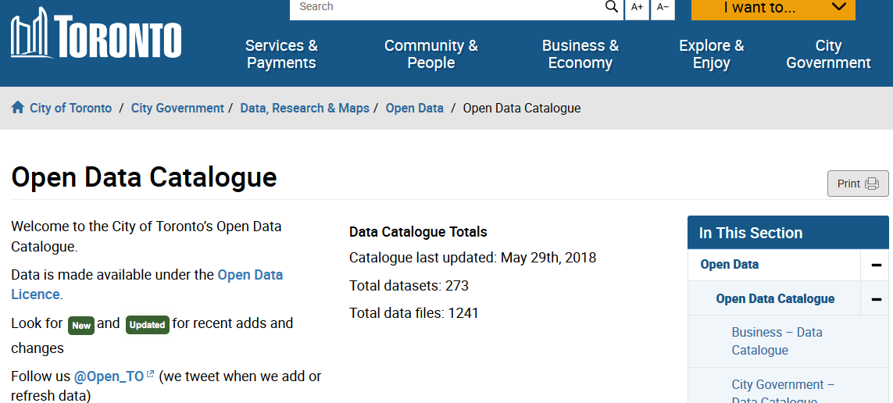
Dataset from Toronto opendata
You can find the link for download on:
https://www.toronto.ca/city-government/data-research-maps/open-data/open-data-catalogue/#7c8e7c62-7630-8b0f-43ed-a2dfe24aadc9

Slide 34
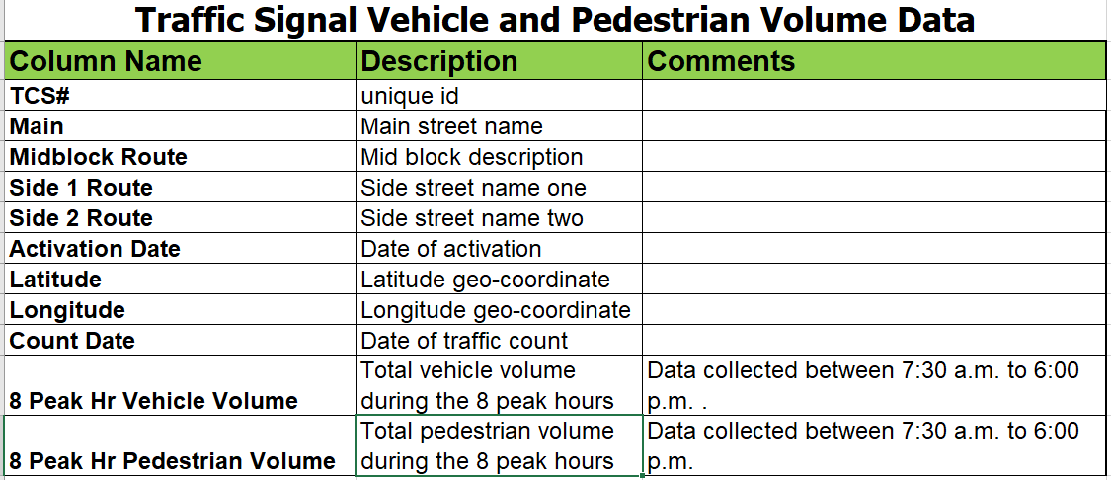
Dataset from Toronto opendata

